Slide 1
Bright Network Technology Academy
Framework for Onboarding and Ongoing Support
May 2022

Slide 2
Continuous Integration Continuous Deployment Continuous Delivery
What, why, how?
May 2022

Slide 3

What’s a Pipeline?
In modern software delivery, we refer to a pipeline as a series of automated steps to build, test and deploy code from a shared repository (e.g. GitHub / Azure DevOps / Bitbucket).
A pipeline’s purpose is to automate repetitive tasks.
Notes:
Developers are inherently lazy. We don’t like doing boring, repetitive tasks
We write scripts to automate the boring repetitive tasks
This is exactly what a pipeline is - a series of automated tasks which test, build and deploy software

Slide 4
What is CI/CD?
Notes:
In this section we hope to introduce the central CONCEPTS which we will use to explain the CI/CD approach to solving the problems identified in the previous section

Slide 5
Continuous Integration (CI/CD)
Continuous integration combines the code you are working on with your team.
The underlying principle is essentially combining the code that you are working on, with the code your team is working on while trying to ensure that nothing is broken in the process.
In the deployment pipeline pattern, every change in version control triggers a process which creates deployable packages and runs automated unit tests and other validations.
Notes:
CI stands for Continuous Integration and its underlying principle is essentially combining the code that you are working on, with the code your team is working on while trying to ensure that nothing is broken in the process.
In the deployment pipeline pattern, every change in version control triggers a process which creates deployable packages and runs automated unit tests and other validations such as static code analysis. This first step is optimized so that it takes only a few minutes to run. This is called Continuous Integration. If this initial commit stage fails, the problem must be fixed immediately.

Slide 6
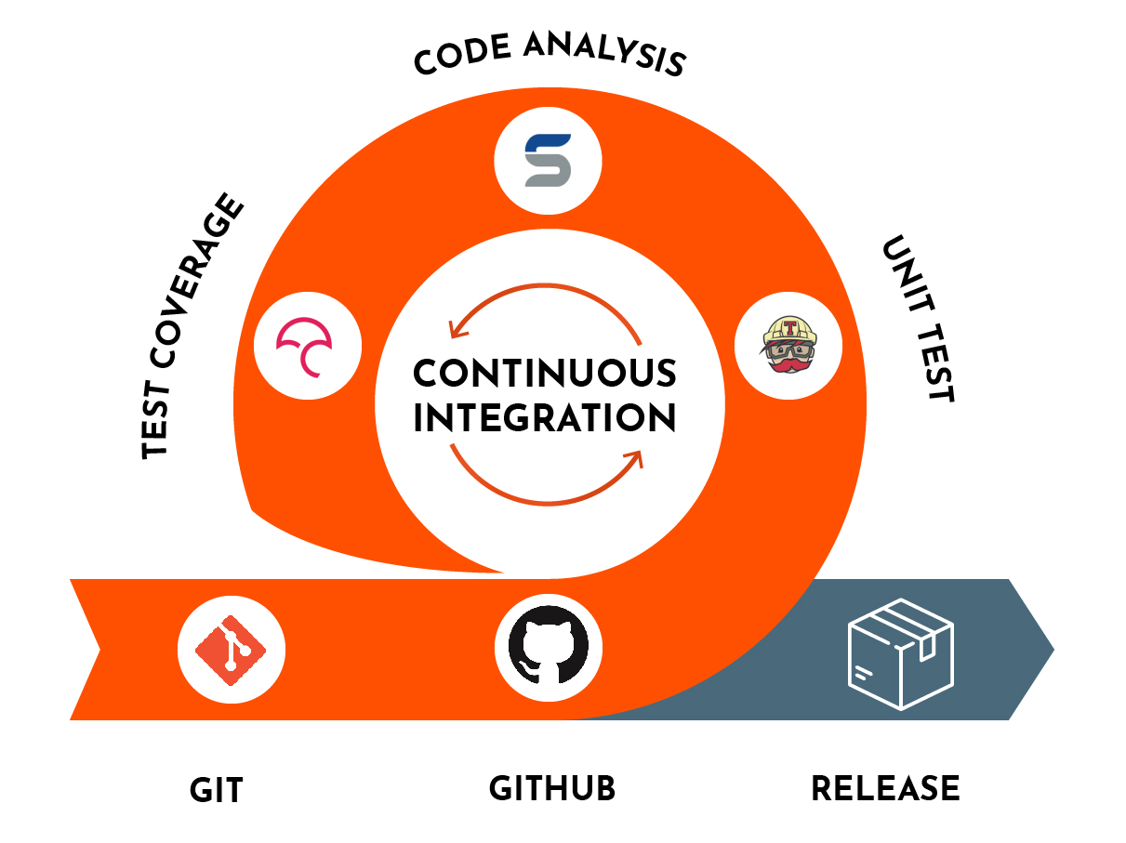
Continuous Integration (CI/CD)
Notes:
In the deployment pipeline pattern, every change in version control triggers a process which creates deployable packages and runs automated unit tests and other validations such as static code analysis. This first step is optimized so that it takes only a few minutes to run. This is called Continuous Integration. If this initial commit stage fails, the problem must be fixed immediately.

Slide 7
Continuous Delivery or Continuous Deployment (CI/CD)
Continuous Delivery and Continuous Deployment get your code into the hands of your users.
Continuous Delivery is the ability to get changes of all types into production, or into the hands of users, safely and quickly in a sustainable way.
Continuous Deployment is a strategy for software releases wherein any code commit that passes the automated testing phase is automatically released into the production environment, making changes that are visible to the software's users.
Notes:
CD can be one of two things, either:
Continuous Delivery is the ability to get changes of all types into production, or into the hands of users, safely and quickly in a sustainable way.
Continuous Deployment is a strategy for software releases wherein any code commit that passes the automated testing phase is automatically released into the production environment, making changes that are visible to the software's users.
Emphasis on iterative delivery of value rather than project delivery (even if operating within the context of a project-centric approach)

Slide 8
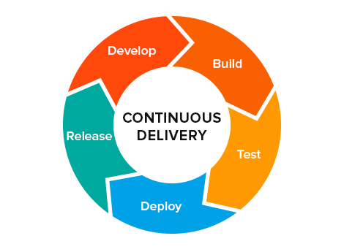
Continuous Delivery or Continuous Deployment (CI/CD)
Notes:
CD can be one of two things, either:
Continuous Delivery is the ability to get changes of all types into production, or into the hands of users, safely and quickly in a sustainable way.
Continuous Deployment is a strategy for software releases wherein any code commit that passes the automated testing phase is automatically released into the production environment, making changes that are visible to the software's users.
Emphasis on iterative delivery of value rather than project delivery (even if operating within the context of a project-centric approach)

Slide 9
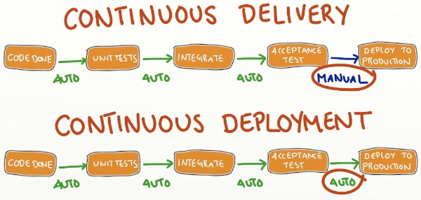
Notes:
Continuous Delivery is Continuous Integration plus the ability to manually trigger an automated deployment to production once the necessary build and test steps have passed. So once your code is integrated, someone is able to trigger a CI process that will deploy the integrated code and relevant artefacts to the production environment. The pipeline has the capability to automatically deploy, but requires a human to make a decision on when trigger it.
Every passing commit stage triggers the next step in the pipeline, which might consist of a more comprehensive set of automated tests. Versions of the software that pass all the automated tests can then be deployed on demand to further stages such as exploratory testing, performance testing, staging, and production, as shown.
CI is a prerequisite to CD

Slide 10
CI/CD and Agile
Manual processes to build, test, and deploy your applications is slow and error-prone. Deploying more frequently in small chunks is less risky because small changes are easier to orchestrate, troubleshoot, and roll-back than one large and complicated deployment. In other words.
Agile without Continuous Delivery/Deployment doesn’t work effectively.

Slide 11
Benefits of CI/CD
Notes:
This section is intended to establish CONNECTION with the audience

Slide 12
Benefits of Continuous Integration
To avoid “Works on my machine™” we need to address human error and bias.
By running on a “Continuous Integration server” code is automatically verified as working in two distinct locations:
Developer’s machine
CI server
Notes:
Works on my machine - works locally but when combined with other changes, or in the absence of local settings, breaks or falls short of agreed upon standards.
Humans:
make mistakes
can be tired
can be lazy
Sometimes code gets pushed without running the necessary checks and bugs get introduced. CI provides a centralised system to check a specific state of the codebase, in an automated, unbiased way and the means to inform those working on it that the state is either correct or that an integration has caused adverse side effects.

Slide 13
Benefits of Continuous Integration
We need continuous, visible information about the health of, and changes to, the codebase.
We need to facilitate standardisation of things like:
Code quality - Automated checking of your source code for programmatic and stylistic errors
Security - Automated checking for vulnerabilities in dependencies
Notes:
Works on my machine - works locally but when combined with other changes, or in the absence of local settings, breaks or falls short of agreed upon standards.
Humans:
make mistakes
can be tired
can be lazy
Sometimes code gets pushed without running the necessary checks and bugs get introduced. CI provides a centralised system to check a specific state of the codebase, in an automated, unbiased way and the means to inform those working on it that the state is either correct or that an integration has caused adverse side effects.

Slide 14

Benefits of Continuous Integration
Knowing what everyone else is doing to the system
CI systems focus on making change and state visible:
What changes kicked off the last pipeline run?
Are the tests passing
Does the code compile?
Notes:
Subsequent slides show examples of integrated commits

Slide 15
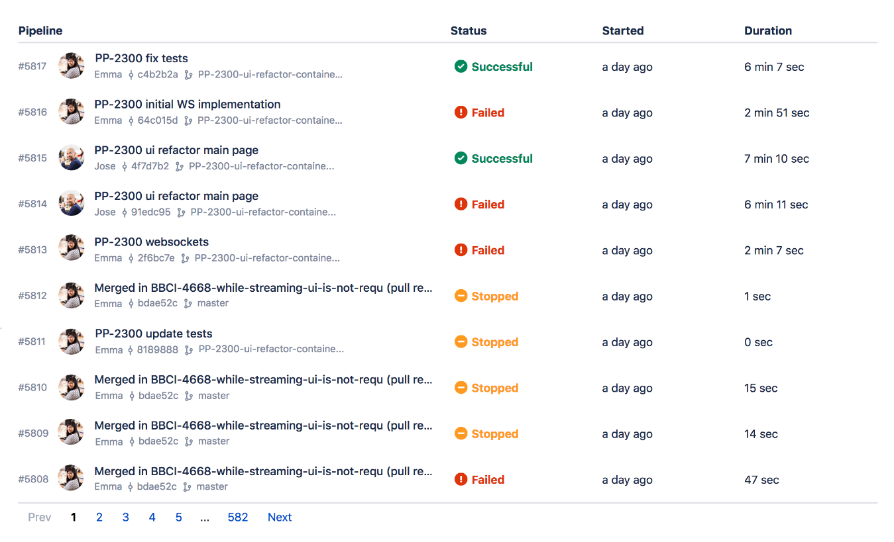

Slide 16
Benefits of Continuous Integration
Standardisation
CI systems focus on making health and standards visible:
Are any dependencies vulnerable to security bugs?
Is test coverage sufficient?
Does the code style meet our agreed standard?
Notes:
Subsequent slide shows examples of various standards being enforced

Slide 17
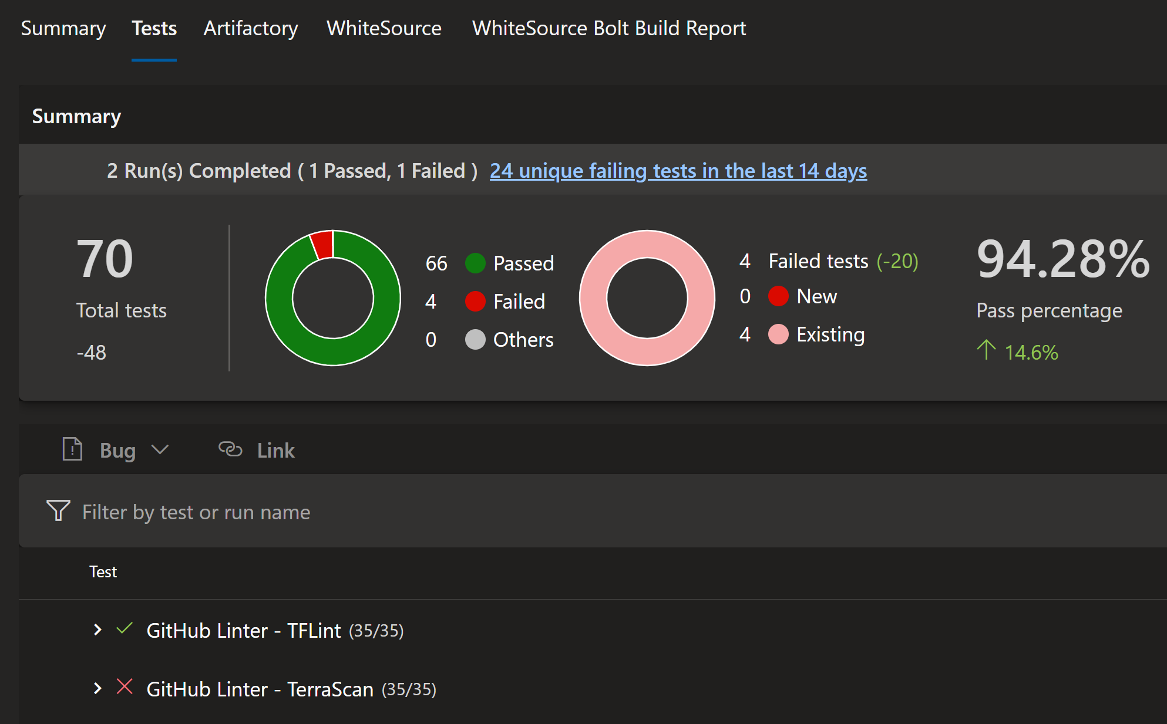
Notes:
Examples of quality metrics - tests and various linters illustrated

Slide 18
Benefits of Continuous Deployment
Automation of the release into production enables more of our time to be focused on building the product.
It also increases the sense of ownership in the product team (as a whole) as each push will immediately head for Prod.
We are also able to ensure that the deployment and release of systems is treated with the same care and attention as all other phases of the product’s development
Notes:
Instead of seeing this in a negative light (“replace the Ops team with DevOps) emphasise that this should be understood as an integration of existing vital team skills into a more holistic way of working.
Shift-left” on deployment decision making - the product team (as a whole) decide when to deploy their work
Modern SaaS-style products create value by the way they are able to rapidly evolve without down-time. Deployment is the product feature which enables that value.

Slide 19

Benefits of Continuous Deployment
Reduce time wasted due to rework and defects
Get the feature in front of a customer quickly to understand if it needs rework faster.
Defects are small and easy to fix closer to the time of creation and can use e.g. Canary Testing to further limit the impact of failure.
Notes:
Subsequent slides show Canary Testing in theory
Note the upcoming

Slide 20
Benefits of Continuous Deployment
Avoiding risk and delay / “Big Bang” releases
Using Continuous Deployment to release small changes into production helps by:
Delivering value as soon as the feature meets pre-agreed standards of functional correctness and non-functional acceptability
We are able to decrease the MTTR (“Mean Time To Recover”) as small changes tend to break in smaller ways
Large changes risk causing a complete outage. Smaller changes which contain defects are less likely to prevent the system being usable.
The change which caused the defect was smaller and so easier to recover
Notes:
“Big bang” releases - the practice of storing up many developed features for e.g. six months to combine together into a single release.
Not suitable for modern applications because:
the risks of a massively compromised service are unacceptable for public-facing or business-critical applications where outages mean huge financial loss
rollbacks are often costly, time-consuming, or even impossible
delivery dates are hard to predict by estimation or even agile techniques such as velocity measurement
the potential impact of building the wrong thing is far higher
Continuous delivery is not magic. It’s about continuous, daily improvement—the constant discipline of pursuing higher performance by following the heuristic “if it hurts, do it more often, and bring the pain forward.”
Subsequent slides show examples of release practices to enable this (such as Blue/Green)
Big-Bang Release
Deployments cause an outage to the production system.
This is not a recommended practice to achieve Continuous Delivery/Deployment
Deployments can be executed in a manner that does not cause an outage to the production system. This can be achieved in many technical approaches.
Deploy with Zero Downtime
Deployments can be executed in a manner that does not cause an outage to the production system. This can be achieved in many technical approaches.
CI/CD reduces the MTTR because the code changes are smaller and fault isolations are easier to detect. One of the most important business risk assurances is to keep failures to a minimum and quickly recover from any failures that do happen. Application monitoring tools are a great way to find and fix failures while also logging the problems to notice trends faster.

Slide 21
Automated releases
Focus on building the product
Once automated, releases are automatic and massively reduce time spent in orchestration and planning because the pipeline can handle the work of orchestrating approval and release when fully automated processes are inadequate.
Release Practices
Rolling Deployment
Blue-Green Deployment
Canary Deployment
Notes:
Rolling Deployment
Rolling, phased, or step deployments are better than big bang deployments because they minimize many of the associated risks, including user-facing downtime without easy rollbacks.
In a rolling deployment, an application’s new version gradually replaces the old one. The actual deployment happens over a period of time. During that time, new and old versions will coexist without affecting functionality or user experience. This process makes it easier to roll back any new component incompatible with the old components.
The following diagram shows the deployment pattern: the old version is shown in blue and the new version is shown in green across each server in the cluster.
An application suite upgrade is an example of a rolling deployment. If the original applications were deployed in containers, the upgrade can tackle one container at a time. Each container is modified to download the latest image from the app vendor’s site. If there is a compatibility issue for one of the apps, the older image can recreate the container. In this case, the new and old versions of the suite’s applications coexist until every app is upgraded.

Slide 22
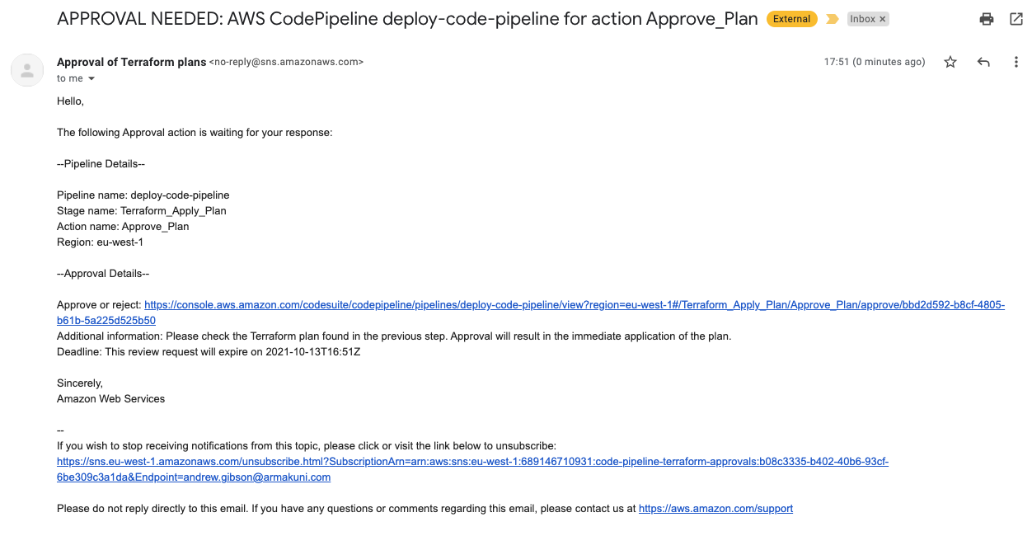

Slide 23
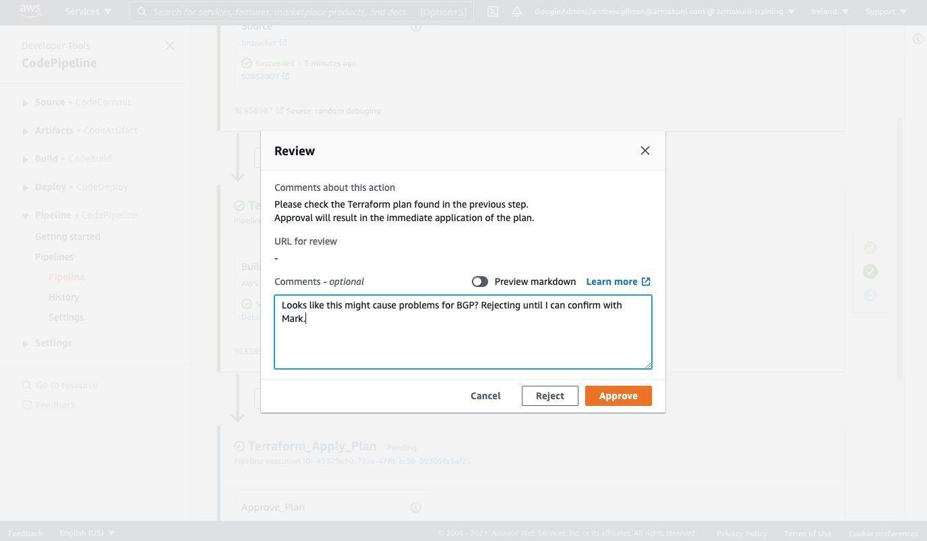

Slide 24
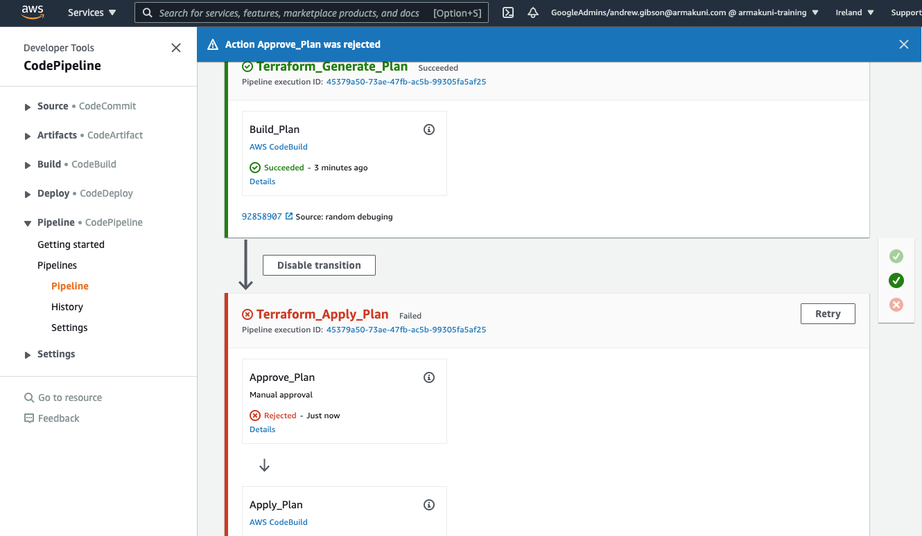

Slide 25
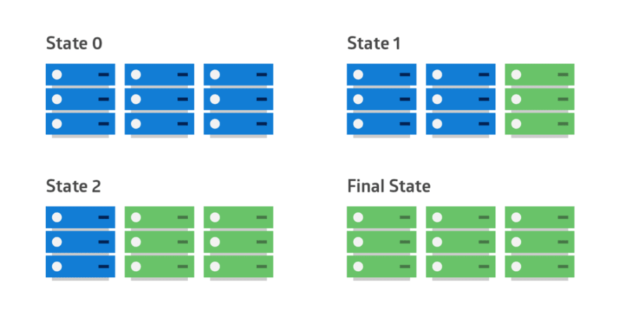
Release Practices - Rolling deployments
Application’s new version gradually replaces the old one.
Deployment happens over time.
New and old versions will coexist.
Easy rollbacks
Notes:
Rolling Deployment
Rolling, phased, or step deployments are better than big bang deployments because they minimize many of the associated risks, including user-facing downtime without easy rollbacks.
In a rolling deployment, an application’s new version gradually replaces the old one. The actual deployment happens over a period of time. During that time, new and old versions will coexist without affecting functionality or user experience. This process makes it easier to roll back any new component incompatible with the old components.
The following diagram shows the deployment pattern: the old version is shown in blue and the new version is shown in green across each server in the cluster.
An application suite upgrade is an example of a rolling deployment. If the original applications were deployed in containers, the upgrade can tackle one container at a time. Each container is modified to download the latest image from the app vendor’s site. If there is a compatibility issue for one of the apps, the older image can recreate the container. In this case, the new and old versions of the suite’s applications coexist until every app is upgraded.

Slide 26
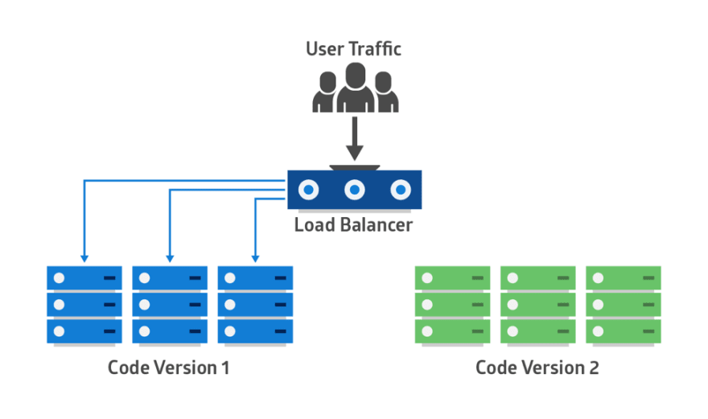
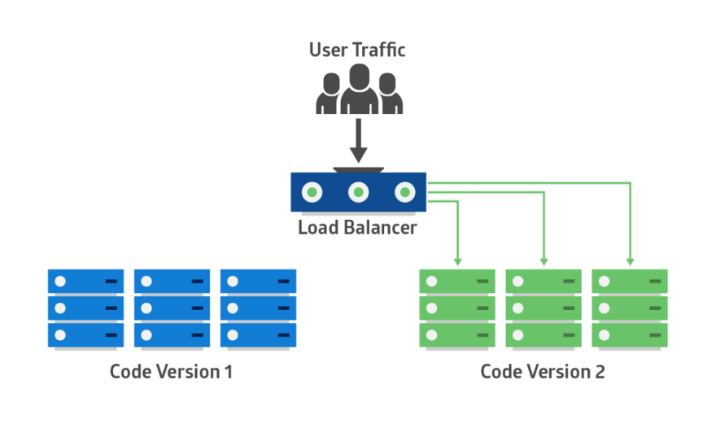
Release Practices - Blue-Green Deployment
Identical production environments (Blue and Green).
Blue receives user traffic, green is a clone on standby.
New application is deployed into green and tested.
All traffic routed to green once testing has passed.
Green is now production.
Can reroute traffic to blue if there is an issue.
Notes:
In this method, two identical production environments work in parallel. One is the currently-running production environment receiving all user traffic (depicted as Blue). The other is a clone of it, but idle (Green).
The new version of the application is deployed in the green environment and tested for functionality and performance. Once the testing results are successful, application traffic is routed from blue to green. Green then becomes the new production.
If there is an issue after green becomes live, traffic can be routed back to blue.
Further
Extensions to this method allow multiple versions of the system to be maintained in a running state which allows for restoration of previous versions in the event of a significant problem (e.g. Azure “slots”)

Slide 27
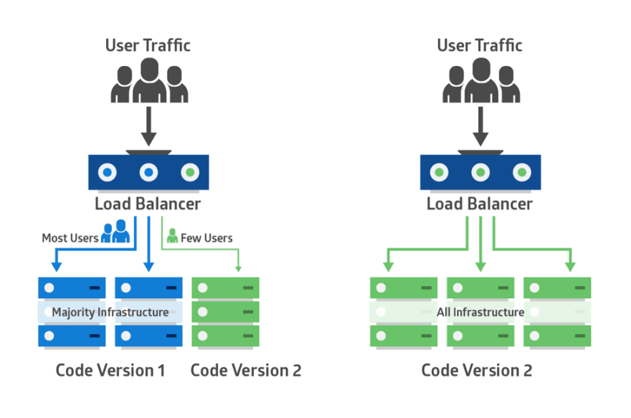
Release Practices - Canary Deployment
Like Blue-Green but more risk-averse.
Instead of single step switching from blue to green, use a phased approach
Only a few users are routed to the new version until confidence builds
Minimises potential impact of change
Notes:
With no errors reported, the new version can gradually roll out to the rest of the infrastructure.
The main challenge of canary deployment is to devise a way to route some users to the new application.
Some applications may always need the same group of users for testing, while others may require a different group every time.
Techniques for routing cohorts of users:
Exposing internal users to the canary deployment before allowing external user access;
Basing routing on the source IP range;
Releasing the application in specific geographic regions;
Using application logic to unlock new features to specific users and groups. This logic can be removed when the application goes live for the rest of the users.

Slide 28
Other pipeline uses
Scheduled Pipeline execution
Schedule regular tasks automated vulnerability scanning renewal of TLS/SSL certificates
Pipelines kicked off by “robots” in response to external factors (e.g. new versions of dependencies)
Notes:
Subsequent slide shows an example of a dependency bot scheduling a PR in github which will initiate a pipeline run once “peer reviewed” by human actors.

Slide 29
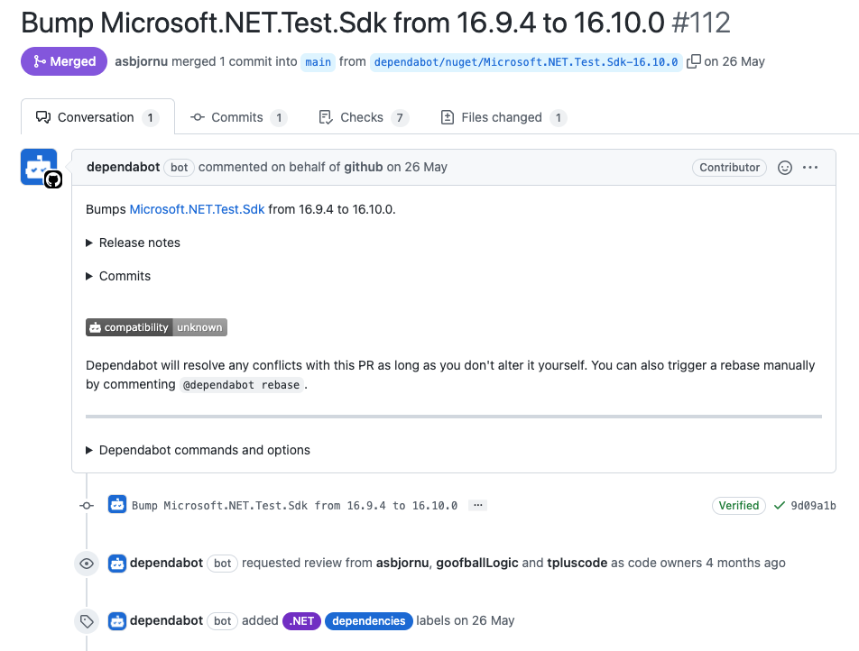
Notes:
Note that the bot not only initiates the action but also solicits participation from human actors just like a human peer would do.

Slide 30
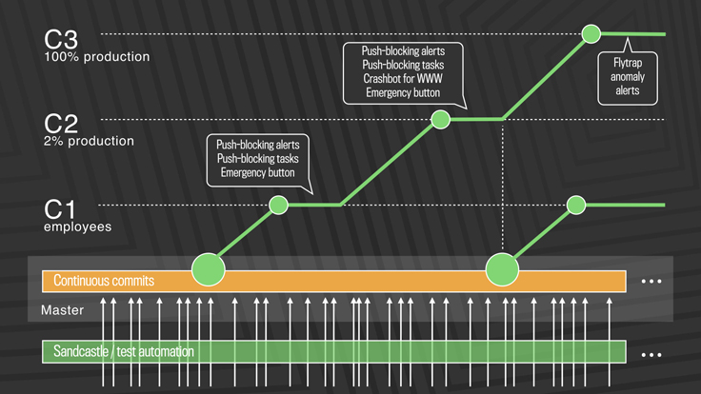
Case Study - Facebook
Notes:
While a true continuous push system would deliver every individual change to production soon after it landed, the code velocity at Facebook required us to develop a system that pushes tens to hundreds of diffs every few hours. The changes that get made in this quasi-continuous delivery mode are generally small and incremental, and very few will have a visible effect on the actual user experience. Each release is rolled out to 100 percent of production in a tiered fashion over a few hours, so we can stop the push if we find any problems.
It eliminates the need for hotfixes.
It allows better support for a global engineering team.
It provides a forcing function to develop the next generation of tools, automation, and processes necessary to allow the company to scale.
It makes the user experience better, faster.
This is essentially GitLab Flow: https://docs.gitlab.com/ee/topics/gitlab_flow.html

Slide 31
The Deployment Pipeline

Slide 32
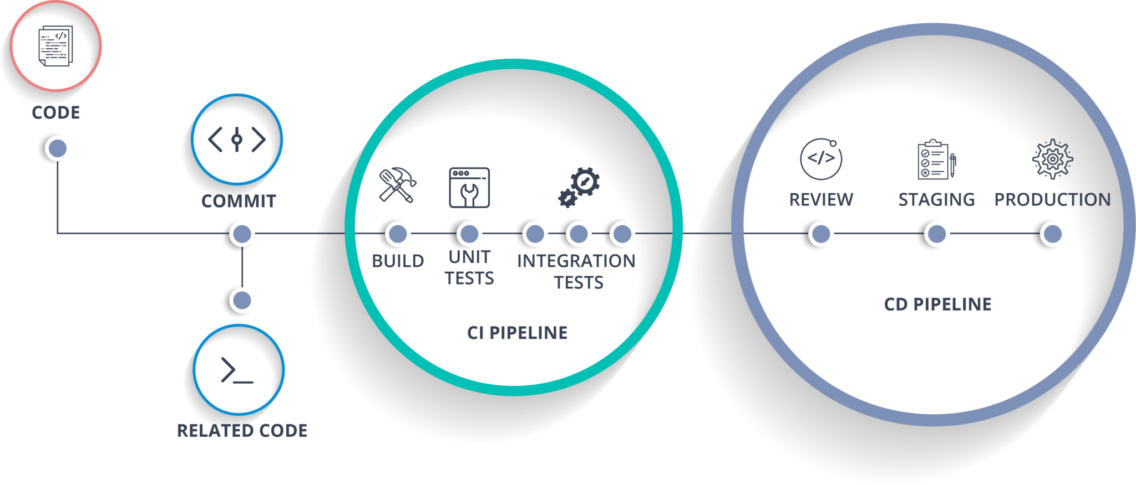
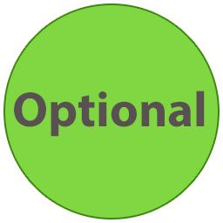
The Deployment Pipeline
Having a deployment pipeline enables more of
our time to be focused on building the product.
Typical steps in a deployment pipeline:
Trigger - A change to the code is made
Checkout - Code is copied into the pipeline
Build - Code is packaged and checked for compilation errors
Unit Tests - Execute the component level tests in the code base
Integration Tests - Ensures components of code correctly interact with each other
Acceptance Tests - Tests to ensure requirements are met
Deploy - Update production with the new, tested version of the project
Notes:
After making a new change in the code (commit) A Continuous Integration Pipeline should be triggered to validate and build the product artifact.
Then, the Continuous Delivery Pipeline will test that artifact on production-like environments until it reaches production.
Check out code
Make changes
Run tests locally
Commit changes
Push changes
CI
Detect changes
Pull latest code
Initiate build
Create artefacts, run analyses and tests

Slide 33
Let’s do it!

Slide 34
Why use CI/CD?
Integrate
Deliver
Deploy
Avoid “Works on my machine™”
Understand health and change within the system
Standardise approaches to linting, security and code style
Avoid the risk and delay associated with “Big Bang” releases
Reduce time wasted due to rework and defects
Focus more of our time on building the product
Increase the sense of ownership in the product team (as a whole)

Slide 35

‹#›

